Slide 1
Sarah Rizvi CS-250 16 April 2023
Scrum Review and Retrospective for SNHU Travel Project

Slide 2
SDLC
SDLC stands for Software Development Life Cycle.
SDLC is a framework that describes the activities performed at each stage of a software development project.
SDLC can be considered as a process of creating, deploying, using and maintaining an information system.
Informational system is considered as collection of interrelated components that collect, process, store and provide the information as an output in order to complete the business task.

Slide 3
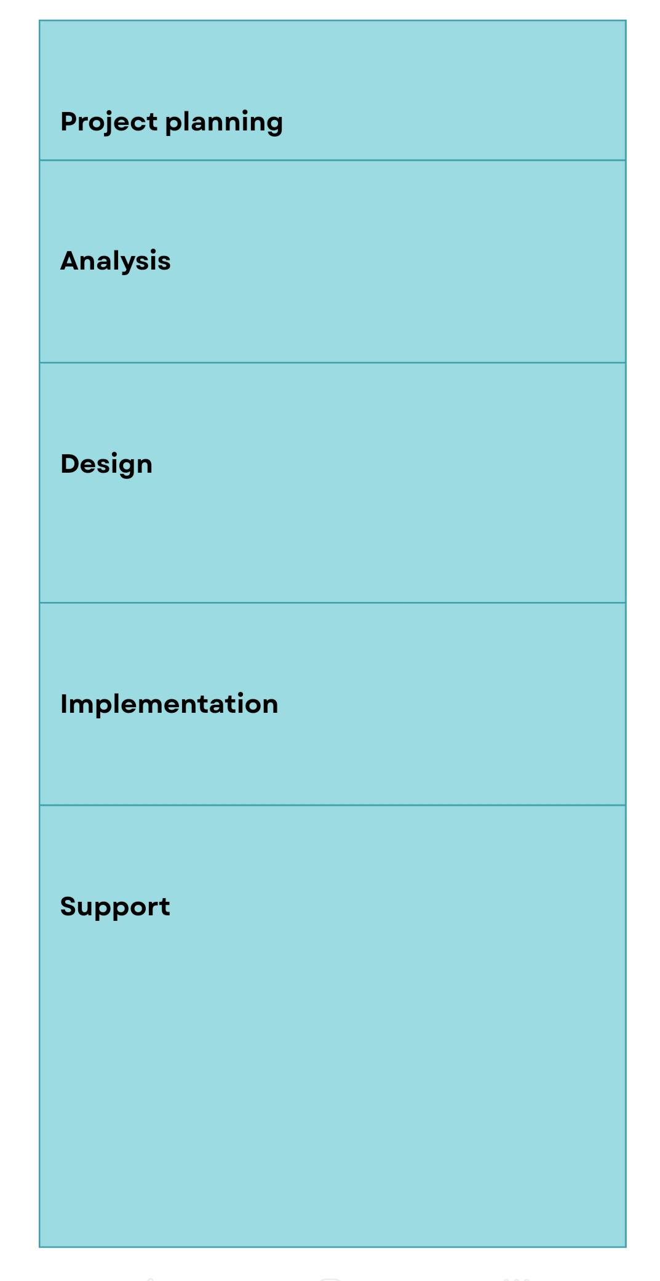
DIAGRAM

Slide 4
PHASES
Project Planning Phase:
Primary goal of this phase is to identify Scope of the project.
In this phase, feasibility of the system is judged.
Resource plan, schedule and budgets are decided.

Slide 5
Analysis phase:
In this phase, the business needs are analyzed & documented.
Various requirement and analysis is also done such as:
Gathering system requirements.
Building prototypes for discovering requirements.
Evaluating alternatives.
Reviewing requirements.

Slide 6
Design phase:
In this phase, the requirements which are analyzed in analysis phase are modeled.
Various tasks are performed during design phase such as:
Application architecture.
Network.
User interfaces.
System interfaces.
Databases.
Prototypes.
System controls.

Slide 7
Implementation phase
In this phase, reliable information system is implemented usually using some programming language such as C, C++, C#, JAVA etc.
Major activities carried out during implementation phase are:
Constructing of software components.
Verification and testing of code.
Conversion of data.
Training the users and documentation of the system.
Installing the system in working environment.

Slide 8
Support Phase
The objective of this phase is to keep the system in running state for many years.
Various activities that are carried out in this phase are:
Maintaining the systems.
Enhancing the systems.
Provide support for users of the system.

Slide 9
6 Stages of the Agile Development Life Cycle
Scope out and prioritize projects
Diagram requirements for the initial sprint
Construction/iteration
Release the iteration into production
Production and ongoing support for the software release
Retirement

Slide 10
The scrum roles are as:
Scrum Master
Product Owner
Scrum Team
Stakeholders

